Slide 1
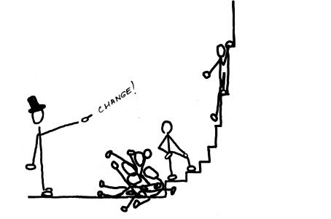
Learning Techniques in AI

Slide 2
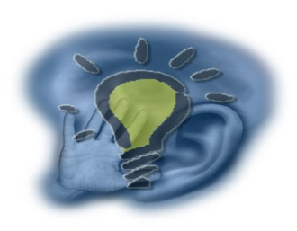
Learning
Learning is a process by which a system acquires knowledge.
Learning is the activity that enables the system to do the same task more efficiently and more effectively next time.
Learning is the key to improve a system’s performance.
Approaches towards Learning
  Skill Refinement
  Knowledge Acquisition
  Taking Advice
  Problem Solving
  Induction
  Discovery
  Analogy

Slide 3

How can we learn?
Skill refinement
  one can learn by practicing, e.g. playing the piano.
Knowledge acquisition
  one can learn by experience and by storing the experience in a knowledge base. One basic example of this type is Rote learning.
Taking advice
  Similar to rote learning although the knowledge that is input may need to be transformed (or operationalised) in order to be used effectively.
Problem Solving
  if a person solves a problem he may learn from this experience. The next time he sees a similar problem he can solve it more efficiently. This does not usually involve gathering new knowledge but may involve reorganization of data or remembering how to achieve the solution.

Slide 4
How can we learn?
Induction
  One can learn from examples. Humans often classify things in the world without knowing explicit rules. Usually involves a teacher or trainer to aid the classification.
  An inductive approach involves the learners detecting, or noticing, patterns and working out a 'rule' for themselves before they practise the language. A deductive approach (rule-driven) starts with the presentation of a rule and is followed by examples in which the rule is applied.
Discovery
  Here one learns knowledge without the aid of a teacher.
Analogy
  If a system can recognize similarities in information already stored then it may be able to transfer some knowledge to improve the solution of the task at hand.

Slide 5
Major paradigms of machine learning
Rote learning – One-to-one mapping from inputs to stored representation. “Learning by memorization.” Association-based storage and retrieval.
Induction – Use specific examples to reach general conclusions.
Clustering – Unsupervised identification of natural groups in data.
Analogy – Determine correspondence between two different representations.
Discovery – Unsupervised, specific goal not given.
Genetic algorithms – “Evolutionary” search techniques, based on an analogy to “survival of the fittest”.
Reinforcement – Feedback (positive or negative reward) given at the end of a sequence of steps.

Slide 6
Learning from Examples
Inductive Learning or Concept Learning
It is concerned with finding a hypothesis from groups of positive and negative examples.
positive examples + negative examples + background knowledge => hypothesis
It is a system that tries to induce a general rule based on observed instance.
It is a kind of supervised learning, where examples are provided with classifications.

Slide 7
The inductive learning problem
Extrapolate from a given set of examples to make accurate predictions about future examples.
Supervised versus unsupervised learning
  Learn an unknown function f(X) = Y, where X is an input example and Y is the desired output.
  Supervised learning implies we are given a training set of (X, Y) pairs by a “teacher”
  Unsupervised learning means we are only given the Xs and some feedback function on our performance.
Concept learning or classification
  Given a set of examples of some concept/class/category, determine if a given example is an instance of the concept or not.
    If it is an instance, we call it a positive example.
    If it is not, it is called a negative example.
    Or we can make a probabilistic prediction (e.g., using a Bayesian net)

Slide 8
The Inductive Learning Problem
Given: Training examples (x; f(x)) for some unknown function f
Find: A good approximation to f.
Example Applications:-
Handwriting Recognition
  x: Data from pen motion.
  f(x): Letter of the alphabet.
Disease diagnosis
  x: Properties of patient (symptoms, lab tests)
  f(x): Disease (or maybe, recommended therapy)
Face recognition
  x: Bitmap picture of person's face
  f(x): Name of the person.
Spam Detection
  x: Email message
  f(x): Spam or not spam.

Slide 9
Discovery as Learning
It is a restricted form of learning that acquires knowledge without the help of a teacher.
It has three categories:-
  Theory Driven Discovery
  Data Driven Discovery
  Clustering
AM : Theory Driven Discovery
  Developed by Dough Lenat.
  AM is an artificial program considered as a successful example of implementing discovery learning.
  AM is a program that discovers concepts in elementary mathematics and set theory.
  AM has 2 inputs:
    Description of some concepts of theory (in LISP). E.g. set union, intersection etc.
    Information on how to perform mathematics. E.g. functions.

Slide 10

Discovery as Learning: AM
Prime Numbers
  factorization of numbers and numbers with only one factor were discovered.
Goldbach's Conjecture
  Even numbers can be written as the sum of 2 primes. E.g. 28 = 17 + 11.
Maximally Divisible Numbers
  numbers with as many factors as possible. A number k is maximally divisible if k has more factors than any integer less than k. E.g. 12 has six divisors 1,2,3,4,6,12.

Slide 11
Discovery as Learning: AM
How does AM work?
AM employs many general-purpose AI techniques:
A frame based representation of mathematical concepts.
  AM can create new concepts (slots) and fill in their values.
Heuristic search employed
  250 heuristics represent hints about activities that might lead to interesting discoveries.
  How to employ functions, create new concepts, generalization etc.
Hypothesis and test based search.

Slide 12
Discovery as Learning: BACON
BACON: based on Data Driven Discovery.
Scientific discovery inspired number of computer models. BACON helps to make hypotheses with collected data from the world in order to validate them.
BACON has been successfully used to (re) discover a number of scientific laws such as Kepler’s Third Law, Ohm’s Law, and Joule’s Law.

Slide 13
Discovery as Learning: Clustering
A collection of a similar type of data is called a cluster and technology behind the collection is called clustering.
It is similar to induction, but difference is that in inductive learning, a program learns to classify objects based on the labeling provided by a teacher.
But in clustering, no class labeling is provided. The program must discover for itself the natural classes that exist for the objects, in addition to a method for classifying instances.
AUTOCLASS is one program that accepts a number of training cases and hypothesizes a set of classes.

Slide 14
Learning by Analogy
Analogy (resemblance) involves a complicated mapping between what might appear to be two dissimilar concepts. It is a powerful inference tool.
  Act cleverly like a fox.
  He is just like a monkey.
Humans quickly recognize the abstractions involved and understand the meaning.
There are two methods of analogical problem solving studied in AI.
  Transformational Analogy
  Derivational Analogy

Slide 15
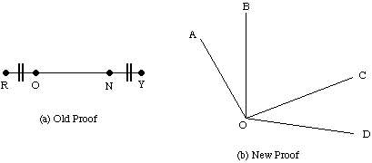
Transformational Analogy
Look for a similar solution and copy it to the new situation making suitable substitutions where appropriate. E.g. Geometry
If you know about lengths of line segments and a proof that certain lines are equal then we can make similar assertions about angles.
We know that lines RO = NY and angles AOB = COD
We have seen that RO + ON = ON + NY
So we can say that angles AOB + BOC = BOC + COD
So by a transitive rule line RN = OY
So similarly angle AOC = BOD

Slide 16
Derivational Analogy
Transformational analogy does not look at how the problem was solved -- it only looks at the final solution.
The detailed history of a problem solving episode is called its derivation.
Carbonell (1986) showed that derivational analogy is a necessary component in the transfer of skills in complex domains:
  In translating C++ code to Java -- line by line translation is no use. You will have to reuse the major structural and control decisions.
  One way to do this is to replay a previous derivation and modify it when necessary.
  If initial steps and assumptions are still valid copy them across.

Slide 17
Explanation Based Learning
Humans appear to learn quite a lot from one example.
Basic idea: Use results from one example’s problem solving effort next time around.
An EBL accepts 4 kinds of input:
A training example
  what the learning sees in the world.
A goal concept
  a high level description of what the program is supposed to learn.
An operational criterion
  a description of which concepts are usable.
A domain theory
  a set of rules that describe relationships between objects and actions in a domain.
From this EBL computes, a generalization of the training example that is sufficient not only to describe the goal concept but also satisfies the operational criterion.

